Slide 1
ID 412 Interactive Space
TA Jeanyoon Choi

Slide 2
Please 1. Access Drive Link (Sent by Email) 2. Take printed lecture materials -- Front of the Class (5 pages each)

Slide 3
About TA
Jeanyoon Choi | Creative Developer, Computational Artist, Interaction Designer
Currently PhD Experience Design Lab (XD Lab) @ KAIST Dep. Industrial Design Prev. MA Information Experience Design @ Royal College of Art Prev. BS Industrial Engineering @ Seoul National University Lectures Convergence Design IV, Lecturer, Korea National University of Arts (K-Arts) Elice Coding Frontend Web Dev. Bootcamp Lecturer Research Topic: Multi-Device Web Artwork

Slide 4
Key Objective of Interactive Space Coding Session
A Creative Frontend Web Development Session
By learning the basics of State-of-the-Art Frameworks (React.js, Next.js) Used in the Frontend Web Industry,

Slide 5
Key Objective of Interactive Space Coding Session
A Creative Frontend Web Development Session
By learning the basics of State-of-the-Art Frameworks (React.js, Next.js) Used in the Frontend Web Industry, You will 1) Develop your Computational Design practice beyond Visual-Oriented Coding 2) Extend the language of web-based medium beyond Commercial/Practical Use-cases 3) Leverage Multi-Device Approaches to design a Multi-Sensory Immersive & Interactive Space

Slide 6
Why Creative Web Dev? Creative Coding vs. Web Dev
Traditional Approach of Art/Design Institution teaching Coding: p5.js / Processing More of Creative Coding rather than Creative Software Easy to learn but limited community / far from industry standard
Creative Web Dev: Hard to learn But easily compatible & integratable with all the Web Industry Standards Dive Deeper into the field of software & frontend engineering More System/Platform/Functionality-Oriented than Creative Coding

Slide 7
Creative Coding vs. Web Dev.
 | Creative Coding | Web Dev
Major Usage | Art School Context | Industry Standard
Focus | Visual-Oriented | Functionality-Oriented
Expandability | Limited | Expandable
Characteristic | Experimental by Nature | Practical by Nature
Community | Small Community | Gigantic Community
Learning Curve | Relatively Easy | Very Hard yet Rewarding (There is no free lunch)

Slide 8
Creative Coding vs. Web Dev.
 | Creative Coding | Web Dev | Creative Web Dev
Major Usage | Art School Context | Industry Standard | Starts from an Art School, Headed towards the Industry
Focus | Visual-Oriented | Functionality-Oriented | Functionality-Oriented
Expandability | Limited | Expandable | Expandable
Characteristic | Experimental by Nature | Practical by Nature | Experimental by Nature
Community | Small Community | Gigantic Community | None (Not yet)
Learning Curve | Relatively Easy | Very Hard yet rewarding (There is no free lunch) | Hard yet rewarding (Now it’s kinda easy w/ LLMs)

Slide 9
Why Creative Web Dev? TouchDesigner vs. Web Dev
TouchDesigner:
Strong in Audio-Visual Creation
Limitation of Node-based Logic
Relatively small community
Limited benefits from the rise of LLMs
Web Development:
(Used to have) a very stiff learning curve
But now with LLMs, your imagination is your only limit
More systemic approach - Narrative-oriented
More compatibility, expandability
More accessibility

Slide 10
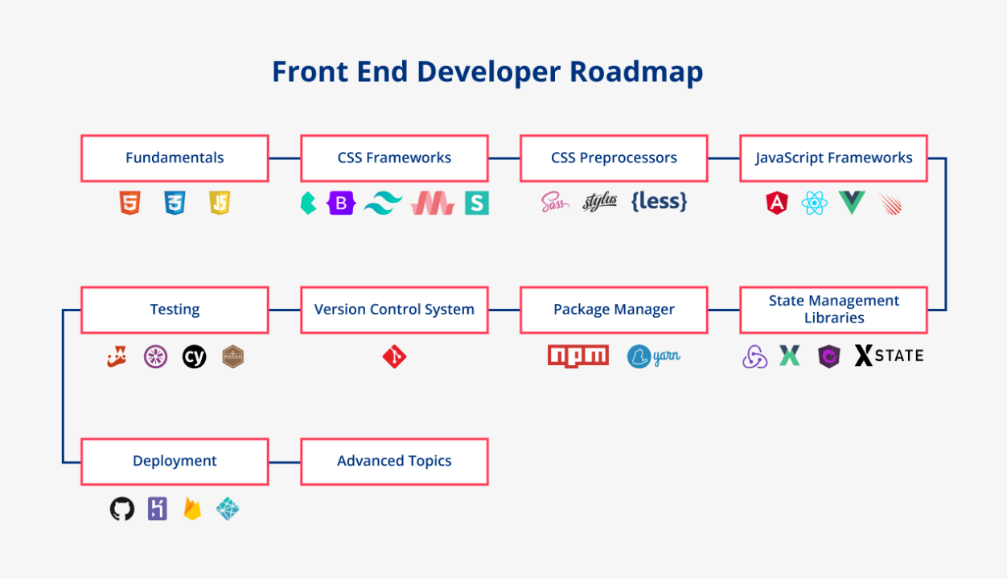
Which Frameworks to focus?

Slide 11
Which Frameworks to focus?

Slide 12
Which Frameworks to focus?
Fundamentals: HTML, CSS, Javascript
CSS Frameworks: Styled-Components (CSS-in-JS)
Javascript Frameworks: React.js
React-based Fullstack Framework: Next.js
Package Manager: Yarn
Version Managing: Git
Deployment: Vercel & Heroku
Code Editor: Cursor AI

Slide 13
Which Frameworks to focus?
Advanced Techniques
Socket.io (W2)
APIs (W2)
Three.js (W3)
Fundamentals: HTML, CSS, Javascript
CSS Frameworks: Styled-Components (CSS-in-JS)
Javascript Frameworks: React.js
React-based Fullstack Framework: Next.js
Package Manager: Yarn
Version Managing: Git
Deployment: Vercel & Heroku
Code Editor: Cursor AI

Slide 14
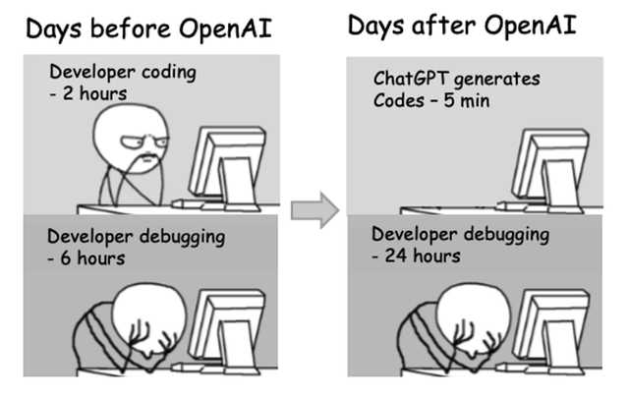
This course wouldn’t be possible… without LLM & Cursor
DO USE ChatGPT, LLMs, Cursor AI within the Class
Make sure you subscribe ChatGPT-4o and/or Cursor AI
You should learn how to interact and iterate using LLMs
Your learning curve… Accelerated much faster

Slide 15

Speculating the future of Coding within the Post-LLM

Slide 16
Speculating the future of Coding within the Post-LLM
Language-based tools with Strong & Large Community will Dominate
React/Next based Frontend Coding
Visual-based/Node-based programming might lose attraction
Lots of traditional Web Developers (might) lose their jobs
BUT Professionals with Domain Knowledge can now integrate Programming very flexibly: It’s an opportunity for you, as designers, to leverage this chance as much as you can
In a near future (cpl of months), programming will become more and more easier
This lecture is already easier than what it should be an year ago, and will be easier next year
Please update yourself on the latest trends and do not hesitate to integrate coding/programming extensively within your design practice/research

Slide 17
Syllabus
Week 1. (10/28)
Basics Settings: Git, Cursor AI, Next.js Intro
Intro to Creative Web Dev:
Time Interval
Mouse Move
Image & Video
Data & Word Puzzle
Week 2. (11/4)
AI APIs Integration: ChatGPT & Dall-E
Multi-Device Integration: Socket.io
Week 3. (11/11)
Three.js & React-Three Ecosystem

Slide 18
Class Tools
Cursor AI (Your Code Editor)
localhost:3000 (Your Live localhost)
Lecture Notes (LINK)
Real-time Code Sharing
Ping Sheet (LINK)

Slide 19
Notes
I cannot help debugging your problem individually. Please use ChatGPT/CursorAI or ask your peers in real-time.
If you are lost, please do ask your peers to help out.
If you are experienced, please do help your peers. Also make sure to update the Ping Sheet in real-time, even if you’re not following the class materials.
Ping Sheet helps me to track the class’s overall understanding. I will adjust the speed accordingly to the Ping Sheet.

